Slide 1


User
Analysis
Team 6:
Vraj Deriya
Riyazul Ansari
Mihika Bodke
Yvonne Yang
Sai Kiran Billa
1

Slide 2

Table
of Contents
Project Context & Objective
User Overview
Pain Points
User Behavior
AI Opportunities & User Readiness
Conclusion
2

Slide 3



Project context
& Objective
Walmart is accelerating digital transformation through e-commerce, advertising, and AI innovation.
Persistent CX challenges long checkouts, stockouts, and limited personalization, impact satisfaction.
Competitors like Amazon outperform Walmart in digital experience and loyalty engagement.
Rising customer expectations make AI essential for personalization, retention, and convenience.
This project analyzes Walmart’s users to identify how AI can enhance experience and strengthen competitiveness.
3

Slide 4

Primary
User Groups
In-Store Shoppers
The core Walmart audience is mainly older adults, suburban/rural families, and middle-income women.
Shop frequently for groceries and essentials, prioritizing convenience and low prices.
Walmart+ Members
Paid segment seeking free shipping, fuel discounts, and fast delivery.
Shows strong digital use and brand loyalty.
Online and Digital Users
16M+ daily visits, driven by Millennials and Gen Z.
Use mobile/web for research, comparison, and purchases; often shop both online and in-store.
Associates/Employees
Large global workforce across stores, logistics, and tech.
Adopting AI and mobile tools to improve operations and customer service.
4

Slide 5
Customer Base & Digital Footprint
Digital Behaviors
Younger users (25–34) are highly mobile and active on the Walmart app.
Frequent use of self-checkout, list-building, in-app discounts, and “store mode.”
Digital engagement drives higher personalization and convenience expectations.
01
03
Demographics
Data Interaction Patterns
Age: Majority of shoppers are aged 45 and above (38%), followed by 35–44 (30%), 25–34 (25%), and under 25 (7%).
Income: 28% High ($125K+), 47% Middle ($40K–$125K)
Gender: 74% Female, growing male and family signups via Walmart+ and e-commerce
Location: 38% Suburban, 32% Urban, 29% Rural strong across all regions
App & Web: Used for checkout, price scanning, and real-time offers.
Loyalty: Walmart Connect links online + in-store data for personalized promotions.
Omnichannel: Walmart Luminate unifies user data across platforms for AI-driven recommendations.
Associates: Employee AI tools improve service and feed operational insights back into systems.
02
5

Slide 6


User
Personas
6

Slide 7


Persona 1 Budget-Focused Suburban Mom
User Description:
Mary is a busy suburban mom who values affordable convenience for her family. She keeps her household running smoothly by shopping in-store 1–2 times per week, primarily for groceries and household essentials. Mary relies on the Walmart app for digital coupons and price comparisons, and she’s a Walmart+ member for delivery and other discounts.
“Walmart helps me keep my family fed and my budget in check, all in one stop.”
Personal Characteristics: Family-oriented Budget-conscious | Hobbies and Interests: Cooking Volunteering at school events
Goals: Save money on every trip Balance time between family and errands | Challenges: Rising costs of groceries Managing family schedules
Needs: Reliable deals and low prices Easy access to digital coupons and offers | Sources of Info: Store circulars/app notifications Friends/family recommendations
Name: Mary Smith
Age: 45 years old
Occupation: Homemaker
Location: Suburban
7

Slide 8

Persona 2 Tech-Savvy Urban Millennial
User Description:
Kenneth is an ambitious urban millennial who embraces technology in every aspect of life. He shops regularly using Walmart’s app and website, buying groceries, electronics, and apparel. Kenneth likes to research products online before buying and often chooses faster pickup and delivery options. His primary motivation is speed, convenience, and personalized deals.
“I want to get what I need quickly, with the best digital experience possible.”
Personal Characteristics: Tech-savvy Multitasker | Hobbies and Interests: Fitness training Streaming tech podcasts
Goals: Seamless online-to-store shopping Find exclusive digital deals | Challenges: Delivery wait times Navigating busy urban stores
Needs: In-app order tracking Fast and flexible pickup/delivery options | Sources of Info: Mobile app alerts Online reviews and influencer recommendations
Name: Kenneth Banks
Age: 25 years old
Occupation: Digital Product Manager
Location: Urban
8

Slide 9
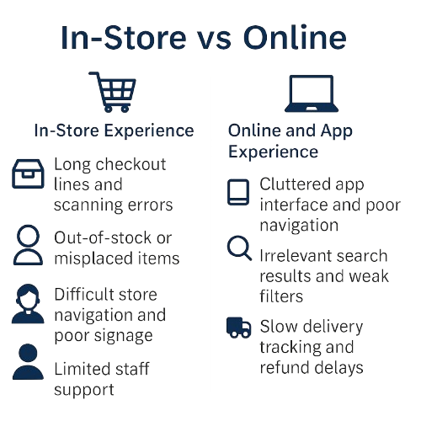
Customer Pain Points
Unmet Needs & Emotional Drivers
Evolving Customer Expectations
Customers seek faster, easier, and more personalized shopping experiences.
Discount strategies
Need for reliability and real-time transparency in orders and delivery.
Effectiveness of loyalty programs
Desire for a loyalty program that builds emotional connection, not just savings.
9

Slide 10





Walmart User Shopping
& Interaction Behavior
Online
In-Store
Mobile-first shoppers: The Walmart App has been the most downloaded U.S. retail app for two consecutive years, indicating a shift toward mobile decision-making.
AI-driven personalization: Generative AI search, product summaries, and virtual assistants enhance relevance and shorten decision time.
Expanding marketplace: Over 700 million SKUs now available; online sales grew +42% YoY in 2024.
Price-sensitive yet convenience-driven: Shoppers increasingly expect fast, personalized, and frictionless digital experiences.
Still the dominant channel: 91.5% of food and beverage purchases occur in physical stores, reinforcing the continued importance of offline shopping.
Checkout friction persists: However, Sam’s Club’s Scan & Go technology has raised satisfaction scores to 85 (+5 pts).
Tactile trust: Older demographics value the ability to see and touch products before purchase.
O2O behavior (Online-to-Offline): Customers increasingly research online and complete transactions in stores or via pickup, underscoring the need for seamless data integration across channels.
10

Slide 11
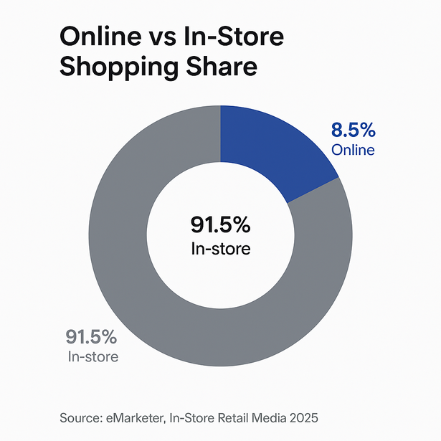
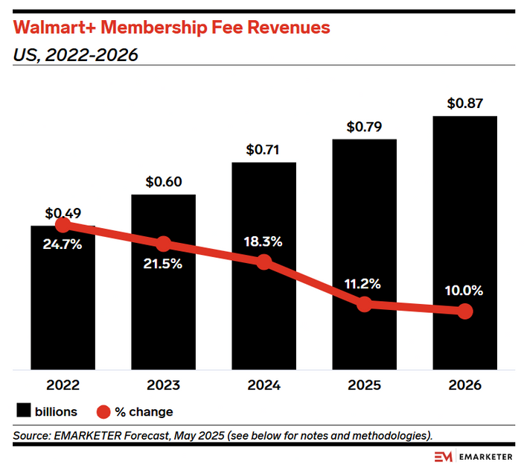
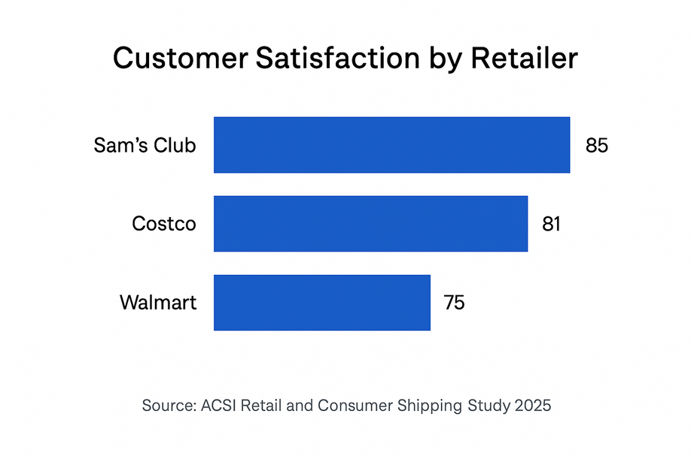
Retail Performance
& Consumer Trends
11

Slide 12

Behavior To
AI Opportunities
BEHAVIORAL INSIGHT | SUPPORTING DATA | AI APPLICATION
Price-sensitive yet willing to pay for convenience | Walmart+ membership revenues ↑ from $0.49 B (2022) to $0.87 B (2026); Gen Z willing to pay for speed (McKinsey 2025; eMarketer 2025). | Dynamic Pricing & Demand Forecasting
High online interaction but limited personalization | AI search and summaries enhanced UX and attracted affluent users (eMarketer 2025). | AI Search & Personalized Recommendation
In-store experience remains dominant | 91.5% of food & beverage sales occur in stores; Scan & Go boosted satisfaction to 85 (ACSI 2025). | Smart Checkout & Predictive Replenishment
Convenience and time-saving drive loyalty | Consumers seek “frictionless and instant” shopping (McKinsey 2025). | AI Assistants & Automated Customer Service
Shift toward interactive media and commerce | Retail media CAGR 21% driven by AI ad personalization (McKinsey 2025). | AI-Powered Commerce Media & Targeted Ads
AI adoption depends on trust and transparency | 61% trust retailers that disclose AI use; 72% expect transparency (Deloitte 2025). | Trustworthy AI Design & Explainable AI UX
12

Slide 13

Mapping Solutions
To Key Pain Points
Customer Pain Point
Primary AI Solution
How It Works
Empty Shelves & Stockouts
Predictive Demand Forecasting & Automated Replenishment
AI analyzes sales data, trends, and external factors (e.g., weather) to predict demand and automate reordering.
Hyper-Personalization Engines & Recommendation Systems
AI analyzes user browsing and purchase history to deliver tailored product recommendations and relevant offers across web and app.
Impersonal Online Experience
Conversational AI provides 24/7 support for routine inquiries (order tracking, returns, store hours), freeing human agents for complex issues. Retail chatbots can boost conversions improve service speed.
Inefficient Customer Support
AI-Powered Chatbots & Virtual Assistants
Frictionless Checkout & Queue Management
Computer vision and sensors can eliminate checkout lines (e.g., Amazon Go) or predict queue lengths to optimize staffing in real-time. This directly addresses a core frustration, aiming to remove the single biggest pain point of the physical journey
In-Store Friction & Long Checkouts
13

Slide 14
User Adoption Readiness
The Engagement Paradox
Rapid Behavioral Adoption
Deep Trust Deficit
The Engagement Paradox
Consumers are actively using AI in their shopping journeys, with adoption accelerating rapidly.
Traffic to U.S. retail sites from generative AI sources grew an astonishing 4,700% year-over-year.(Adobe, 2025)
38% of U.S. consumers have already used generative AI for online shopping, and 52% plan to do so within the year.(Adobe, 2025)
Adoption is highest among younger demographics, with Gen Z and Millennials leading the way.
Despite high usage, a significant trust barrier remains, centered on control and privacy.
66% of consumers would NOT allow an AI to make purchases on their behalf, even if it guaranteed a better price.(Omnisend, 2025).
41% of Americans have "no trust" at all in AI shopping assistants.(YouGov/RetailDive, 2025)
This is driven by the #1 barrier: Data Privacy. Approximately 58-60% of shoppers worry about how AI will handle their personal data.(Attest/Omnisend, 2025)
Despite this stated distrust, shoppers arriving from AI sources are demonstrably more engaged than those from any other channel.
Their visits are 32% longer.
They have a 27% lower bounce rate.
Consumers respond positively to the outcomes of "invisible" AI (like better search results or reliable inventory) that seamlessly improves their experience, even while they harbor distrust for overt, "visible" AI agents.
14

Slide 15
Critical Risks & Resistance Factors
Complexity & Loss of Human Touch
Data Privacy & Security
58-60% of shoppers are actively worried about how AI will use their personal data.
The fear is specific: 81% of consumers believe data collected by AI will be used in ways they are uncomfortable with or for purposes beyond what was intended.(IAPP, 2025)
63% of shoppers aged 50+ worry about losing personal interaction, indicating a key demographic risk for an "AI-first" strategy. (Attest, 2025)
Poor User Experience
The Internal Readiness Gap
39% of shoppers report having abandoned a purchase specifically because of a frustrating AI interaction (e.g., inaccurate recommendations, a bad chatbot). (Omnisend, 2025)
42% feel that the retail AI they encounter today functions more as an "aggressive upselling tool" than as a genuinely helpful assistant, reinforcing skepticism. (Omnisend, 2025)
The greatest threat may be internal, as a lack of preparedness causes the poor user experiences that consumers fear.
While 97% of retailers are investing in AI, only 11% feel fully prepared to deploy it at scale.
The primary internal obstacle is fragmented and siloed customer data (58% of retailers), which makes effective personalization impossible.(TotalRetail, 2025)
15

Slide 16

Conclusion
Walmart’s broad and diverse customer base generates valuable behavioral and transactional data that can fuel AI-driven personalization and engagement.
Persistent CX pain points such as checkout friction, stockouts, and limited personalization highlight the need for AI-powered solutions across both physical and digital touchpoints.
Users are open to AI tools that improve speed, convenience, and accuracy, but trust, transparency, and usability remain key barriers to adoption.
AI’s greatest potential lies in creating seamless omnichannel experiences, strengthening loyalty, and improving satisfaction across customer segments.
To succeed, Walmart must balance technological innovation with a human-centered approach, ensuring AI enhancements do not replace the customer connection.
16

Slide 17
References
Thunderbolt
Business model analyst
Business Dasher
Walmart data ventures
Walmart
Project Pro
Super Market Satisfaction Data
Walmart Retail Reward Report 2025
Walmart’s Investments in Value, GenAI, and Advertising Paid Off in 2024.
In-Store Retail Media 2025.
Retail and Consumer Shipping Study 2025
State of the Consumer 2025: When Disruption Becomes Permanen
Chatgpt(Image generation)
Adobe (2025)
Omnisend (2025)
Total Retail (2025)
ACSI (2025)
Riskified (2025)
IAPP (2025)
Attest (2025)
Retail Dive / YouGov (2025)
xcube Labs (2025)
Fibre2Fashion (2025)
17

Slide 18




Thankyou
18

